Slide 2
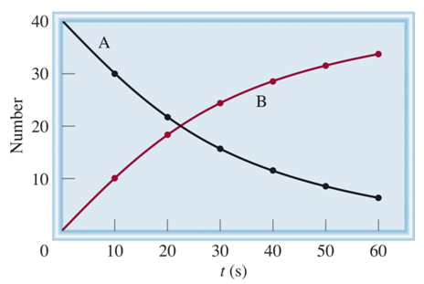
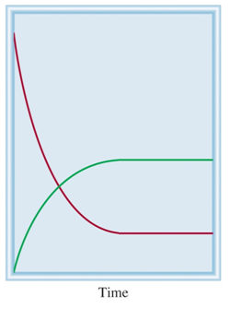
Dynamic Processes
Irreversible process:
A B
A is converted to B until there is no A and only B.
Reversible process:
A B
A
B A
A B
Number
A is in equilibrium with B
B
Neither A nor B are completely consumed during the reaction.

Slide 3
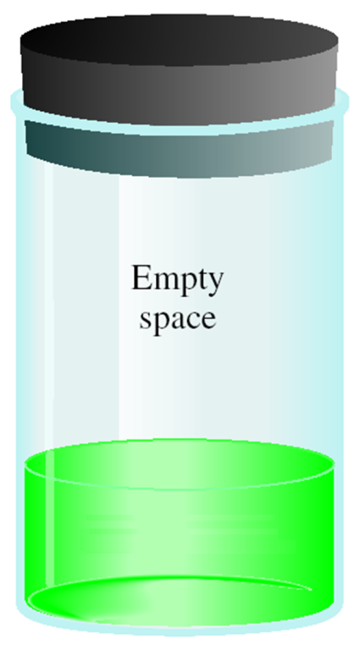
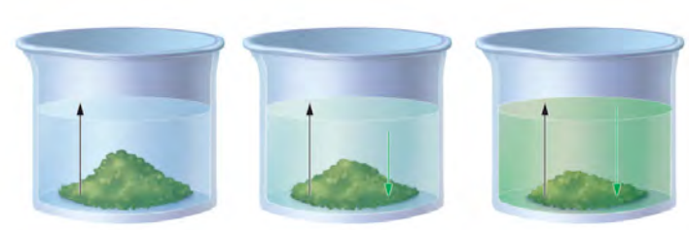
Equilibrium
The change is reversible
The system is “closed”—no substance can enter or leave
The system is dynamic - At the macroscopic level, it appears as if nothing is happening, but at the particulate level, reversible changes are occurring continuously.
Can be at physical equilibrium or chemical equilibrium
A B
Physical Equilibrium- forward and reverse processes occur at the same rate but there is no chemical change.
Solubility
Vapor Pressure
Liquid
At time = 0
At time > 0
At time = ∞
At time = 0
At time > 0
At time = ∞
rate of dissolution
rate of precipitation
rate of vaporization
rate of condensation
=
=

Slide 4
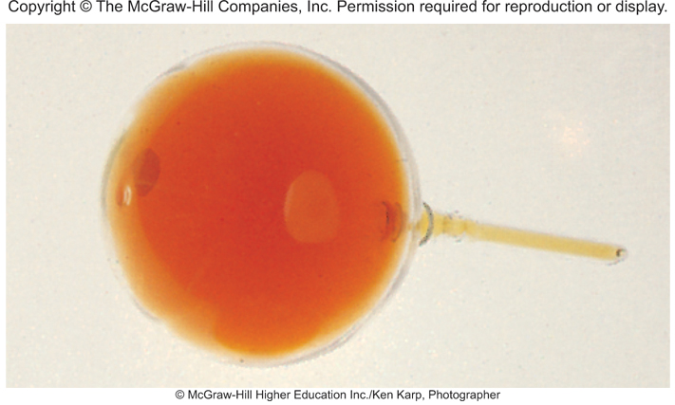
Equilibrium
The change is reversible
The system is “closed”—no substance can enter or leave
The system is dynamic - At the macroscopic level, it appears as if nothing is happening, but at the particulate level, reversible changes are occurring continuously
Can be at physical equilibrium or chemical equilibrium
A B
Chemical Equilibrium-
the rates of the forward and reverse reactions are equal.
a chemical change is occurring (intramolecular bonds broken/formed)
concentrations of the reactants and products remain constant.
this does not mean [conc] of reactants and products are equal!
NO₂
N₂O₄ _{(g)}
2NO₂ _{(g)}

Slide 5
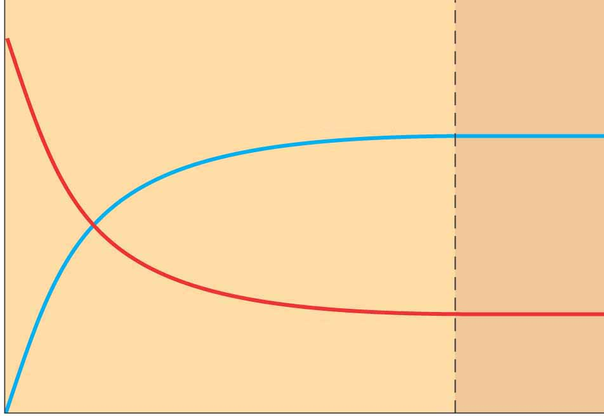
Equilibrium and Rate
At time ~0:
[B] = 0, [A] > 0
B formation = k_{A}[A]
At time 1
[B] > 0, [A] > 0
rate_{A→B} >> rate_{B→A}
At time 2
[B] = [A]
k_{A}/rate_{A→B} = k_{B} / rate_{B→A}
At time 4
[B] > 0, [A] > 0
rate_{A→B} > rate_{B→A}
At time n ◊ ∞
[B] unchanged, [A] unchanged
rate_{A→B} = rate_{B→A}
A B
rate_{A→B} = k_{A} [A]
B A
rate_{B→A} = k_{B} [B]
B
Number
A
0
1
2
4
n
time
At equilibrium!

Slide 6
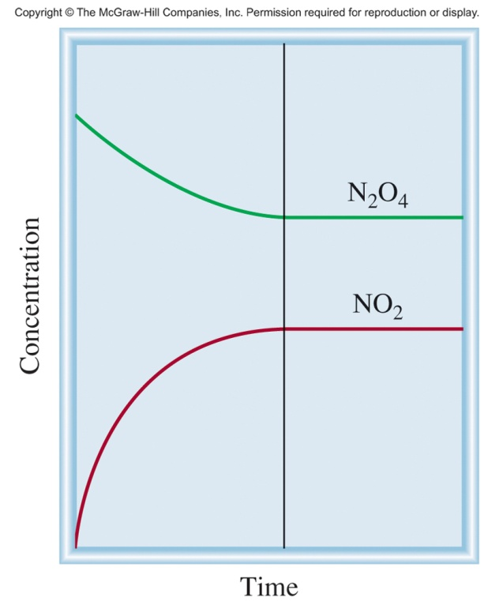
Equilibrium and Rate
N₂O₄ _{(g)}
2NO₂ _{(g)}
Rate_{fwd} = k_{fwd}[NO₂]²
Rate_{rev} = k_{rev}[N₂O₄]
At equilibrium:
Each compound is produced and consumed at the same rate.
Rate_{fwd} = Rate_{rev}

Slide 7
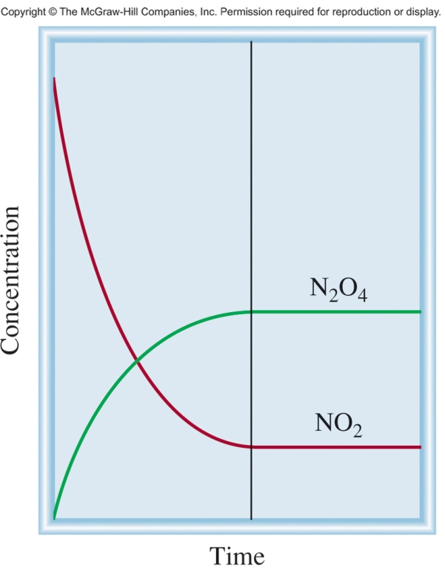
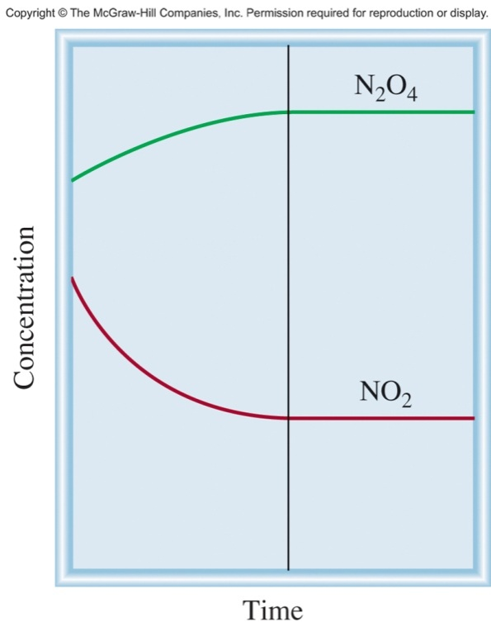
Equilibrium and Rate
N₂O₄ _{(g)}
2NO₂ _{(g)}
equilibrium
equilibrium
equilibrium
Start with NO₂
Start with N₂O₄
Start with NO₂ & N₂O₄
No matter what concentrations you start with, at some point:
Rate_{fwd} = Rate_{rev}
The reaction will reach equilibrium!

Slide 8
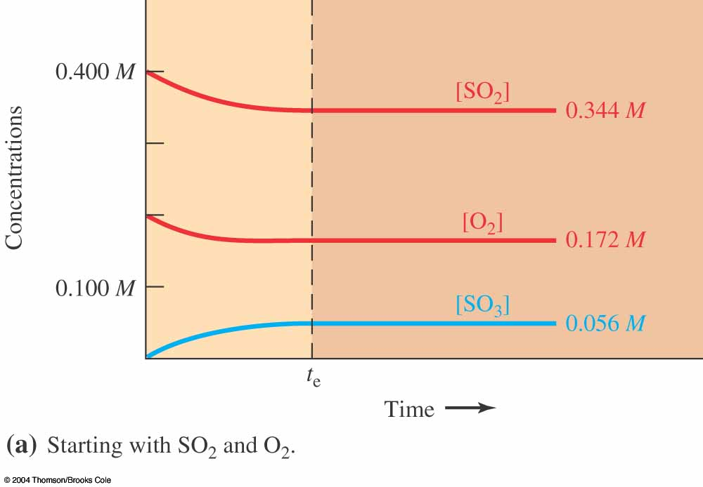
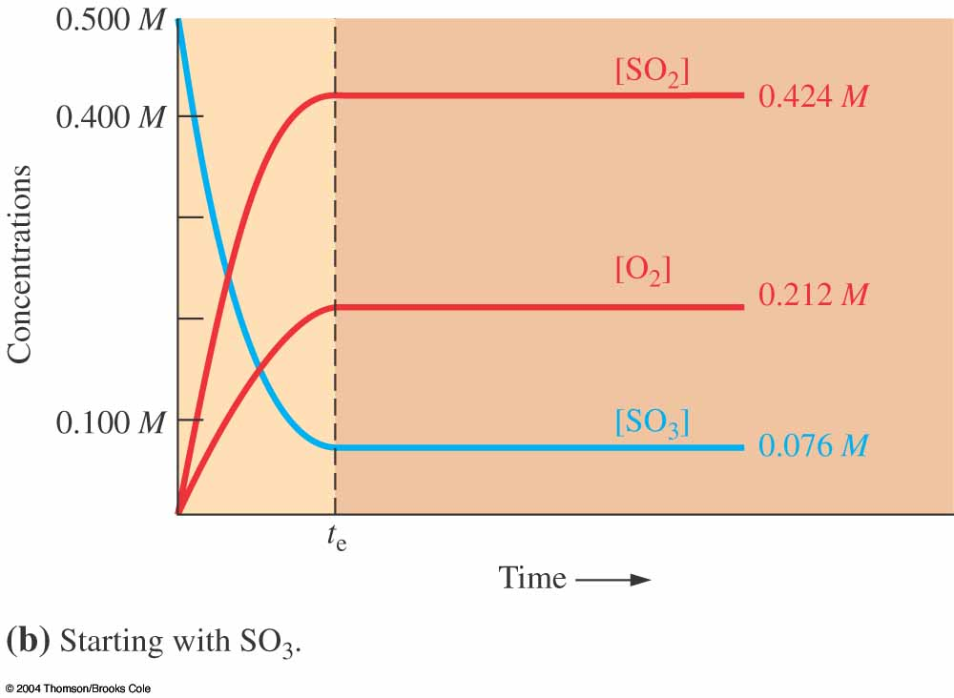
Three Species Equilibrium
No matter what concentrations you start with, at some point:
Rate_{fwd} = Rate_{rev}
The reaction will reach equilibrium!

Slide 10
Equilibrium Concentrations
A B
Equilibrium does not mean that concentrations are all equal!!
However, concentrations at equilibrium are related to the fwd/rev rate constants.
Every equilibrium has its own equilibrium constant.
rate_{A→B} = k_{A} [A]
rate_{B→A} = k_{B} [B]
At equilibrium:
rate_{A→B} = rate_{B→A}
k_{A} [A] = k_{B} [B]
Rate constant A→B
k_{A}
[B]
Rate constant B→A
=
=
K
k_{B}
[A]

Slide 11
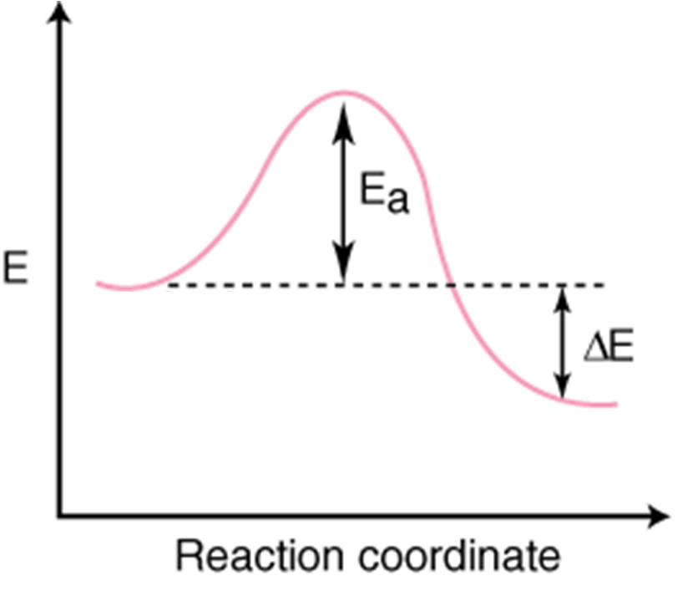
Reaction Diagram
A B
Reverse Reaction
Forward Reaction
k_{A}
=
K
k_{B}
A
B
At equilibrium, the number of balls rolling over the hill in each direction is equal.

Slide 12
Equilibrium Constant
For a general reversible reaction such as:
the equilibrium constant is written as
The equilibrium constant for the overall reaction includes stoichiometric coefficients.
aA + bB cC + dD
Law of Mass Action
General practice is not to include units for the equilibrium constant.

Slide 13
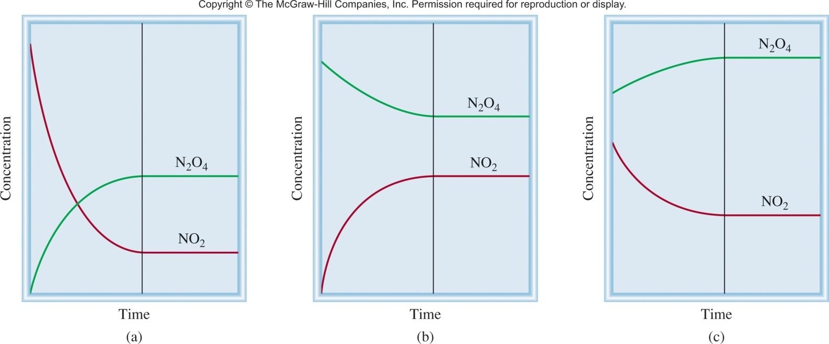
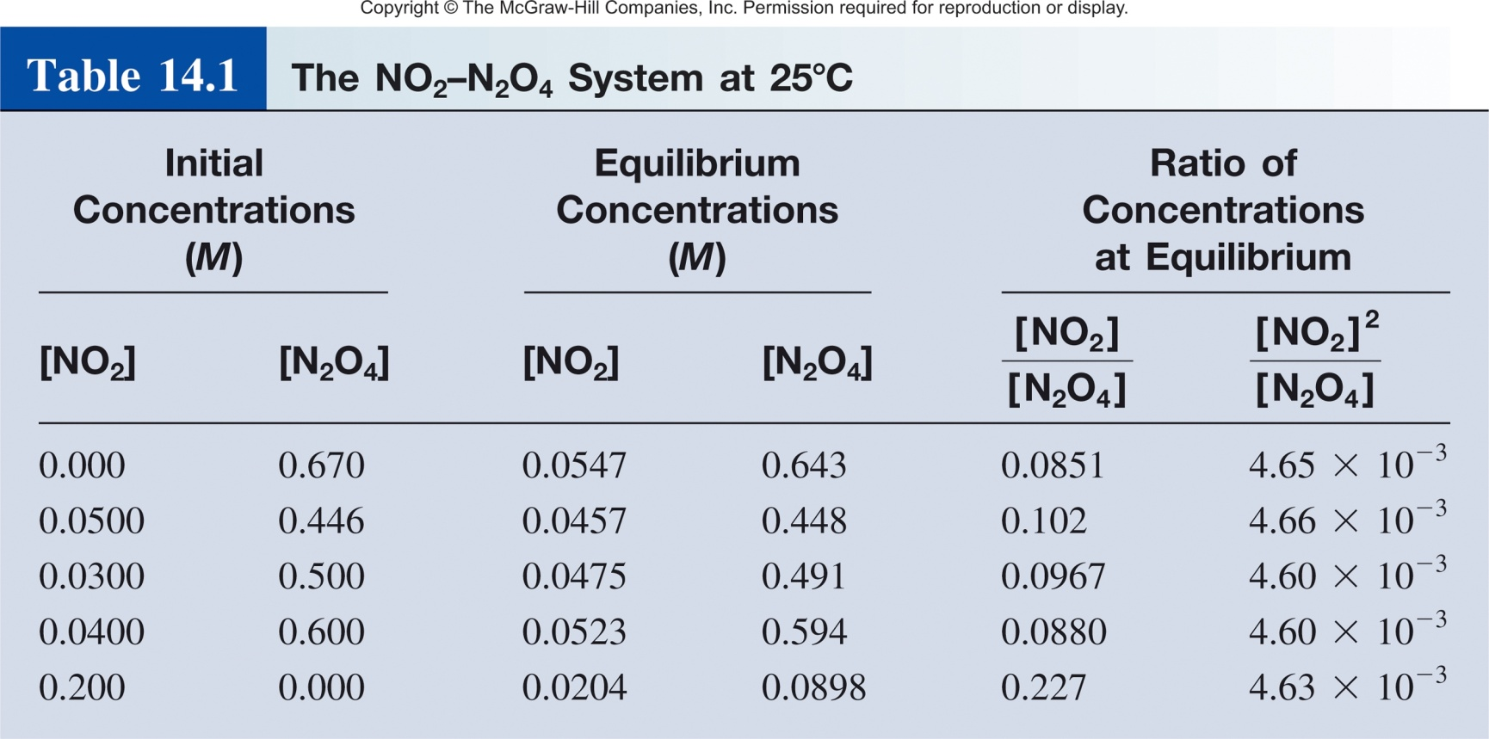
Equilibrium Constant
N₂O₄ _{(g)}
2NO₂ _{(g)}
[NO₂]²
K
=
[N₂O₄]
K
= 4.6 x 10⁻³

Slide 14
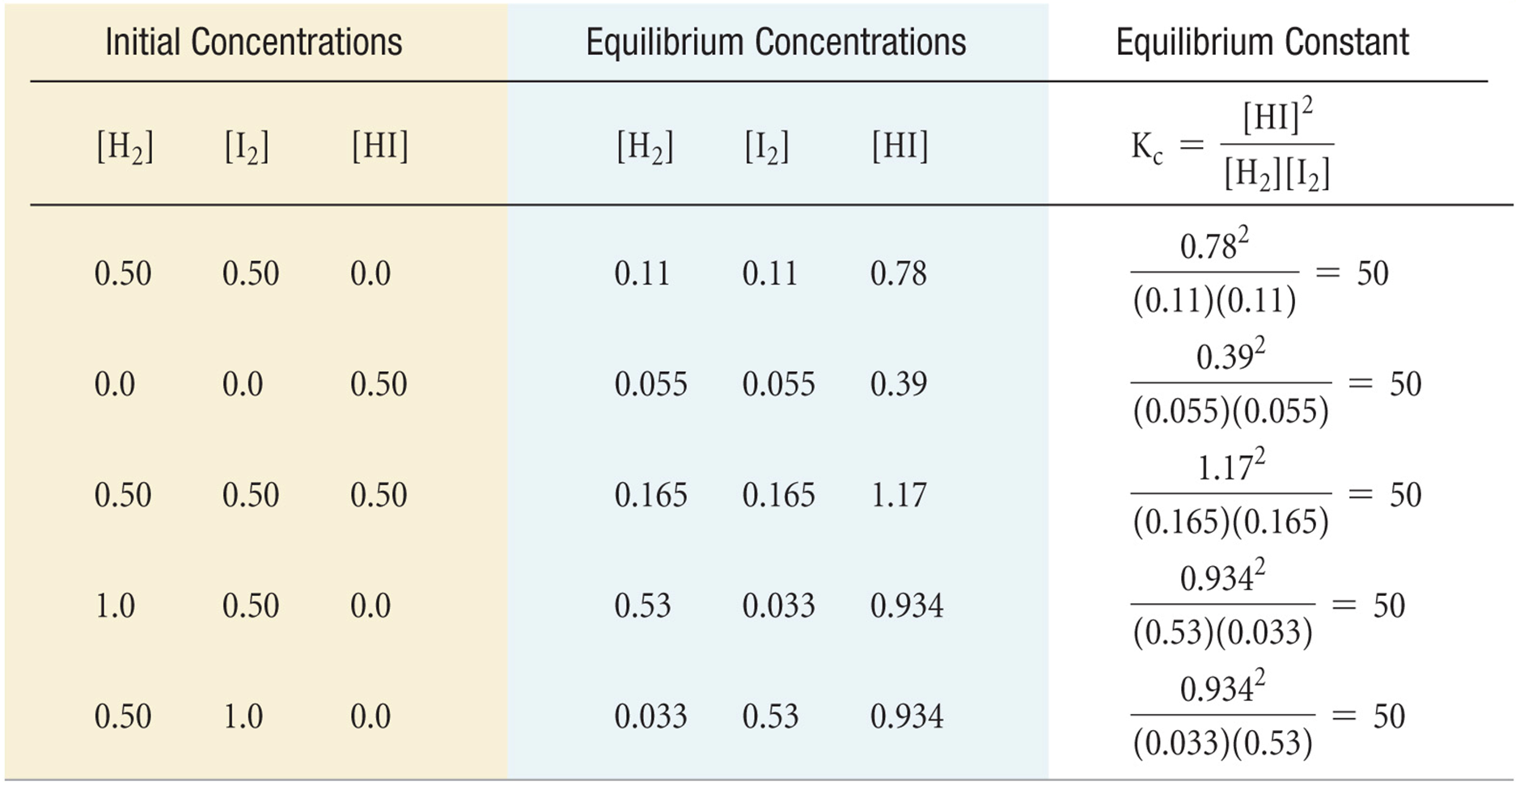
Three Species Equilibrium
No matter how you set up the reaction, the value of the equilibrium constant will be the same if the temperature is the same.

Slide 15
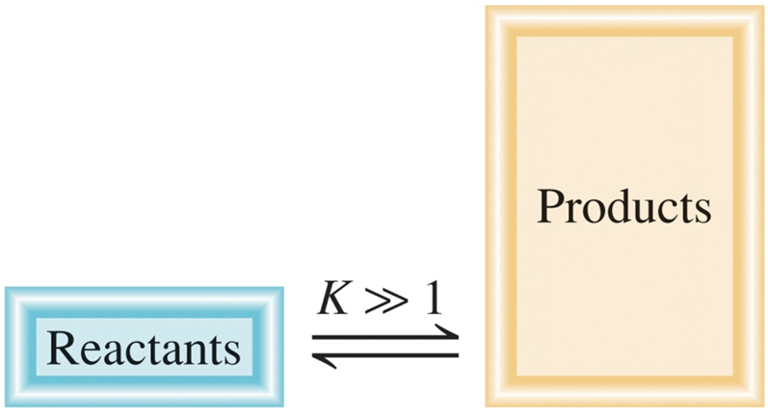
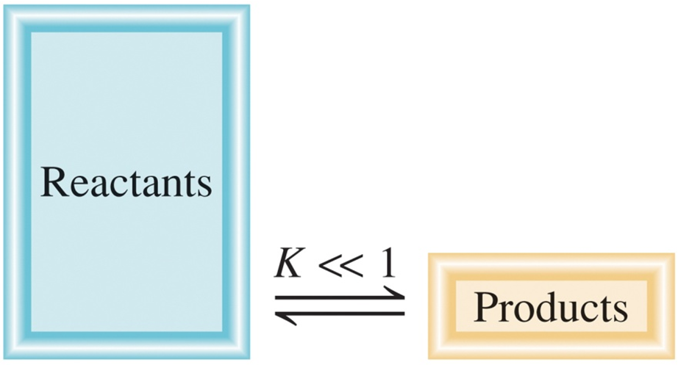
Equilibrium Constant
[C]^{c}[D]^{d}
aA + bB cC + dD
K =
[A]ª[B]^{b}
K >> 1
Favor product formation
k_{fwd} > k_{rev}
aA + bB cC + dD
K << 1
Favor reactant formation
k_{fwd} < k_{rev}
aA + bB cC + dD

Slide 16
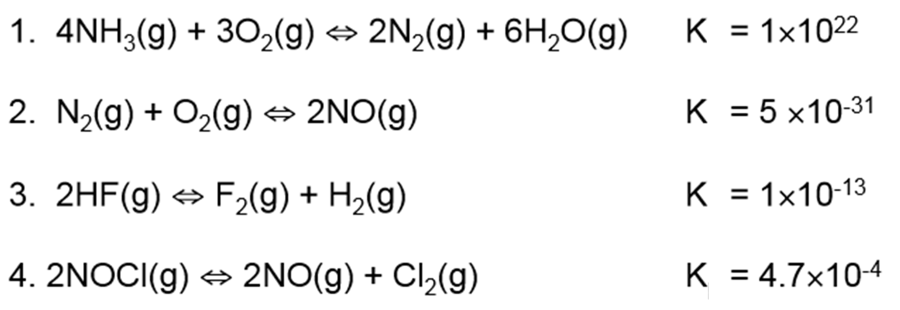
Equilibrium Constant
A)
B)
C)
D)
Question
1) Which reaction most favors the formation of products?
2) Which reaction most favors the formation of reactants?

Slide 17
Equilibrium Constant
For a general reversible reaction such as:
aA + bB cC + dD
Equilibrium constants can be expressed using K_{c} or K_{p}.
K_{c} uses the concentration of reactants and products.
K_{p} uses the pressure of the gaseous reactants and products.
[C]^{c}
[D]^{d}
K_{c} =
[A]ª
[B]^{b}
P_{C}^{c}
P_{D}^{d}
K_{p} =
P_{A}ª
P_{B}^{b}

Slide 18
Equilibrium
N₂O₄ _{(g)}
2NO₂ _{(g)}
In terms of concentration (K_{c})
In terms of pressure (K_{P})
[NO₂]²
P ²
K_{c} =
K_{p} =
NO₂
[N₂O₄]
P
N₂O₄
K_{c} ≠ K_{p}
…at least not always!

Slide 19
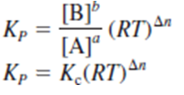
K_{c} vs K_{p}
aA_{(g)}
bB_{(g)}
Substitution

Slide 20
K_{c} vs K_{p}
aA + bB cC + dD
[C]^{c}
[D]^{d}
P_{C}^{c}
P_{D}^{d}
K_{c} =
K_{p} =
[A]ª
[B]^{b}
P_{A}ª
P_{B}^{b}
K_{p} = K_{c}(RT)^{Δn}
Δn = moles of gaseous products – moles of gaseous reactants
Δn = (c + d) – (a + b)
When does K_{p} equal K_{c}?

Slide 21
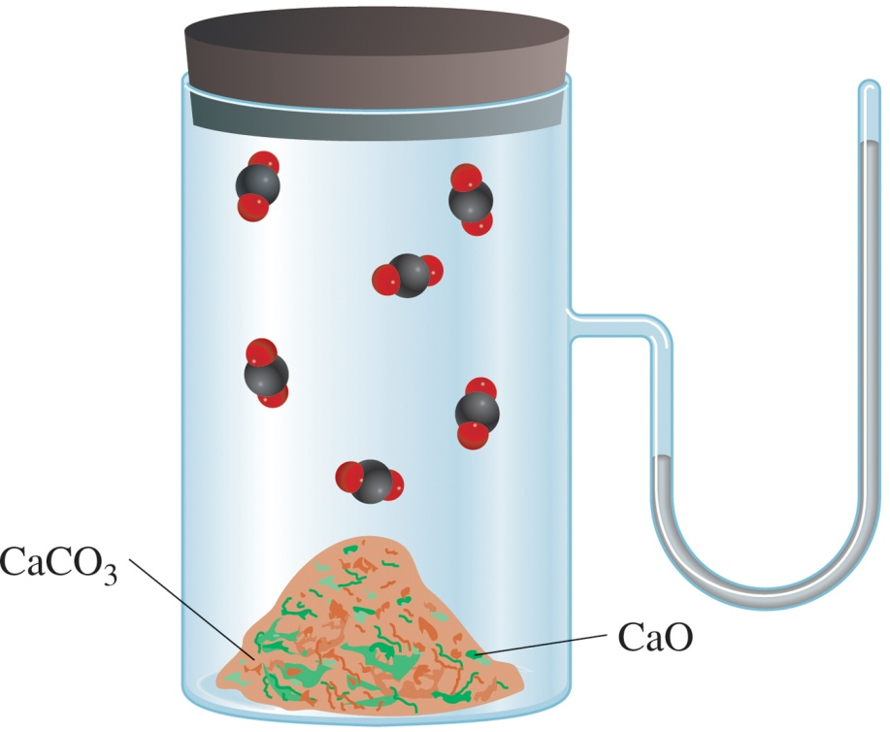
Equilibria: Phases Matter
Homogenous equilibrium- all reacting species are in the same phase.
Heterogeneous equilibrium- reacting species are in different phases.
gas – gas
liquid-liquid
liquid-aqueous
gas – liquid
liquid-solid
solid-gas
N₂O₄ _{(g)}
2NO₂ _{(g)}
CaCO₃ _{(s)} CaO _{(s)} + CO_{2(g)}

Slide 22
Homogenous Equilibria
-all reacting species are in the same phase.
gas-gas equilibria
N₂(g) + 3H₂(g) ⇄ 2NH₃(g)
[NH₂]²
P_{NH3}²
K_{c} =
K_{p} =
[N₂][H₂]³
P_{N2}
P_{H2}³
CH₄(g) + 3H₂O(g) ⇄ CO_{(g)} + 3H₂(g)
H₂O is often used as a solvent(l). However, if H₂O is written as a gas (g), then its concentration must be considered in K_{c} and K_{p}.
[CO]
[H₂]²
P_{CO}
P_{H}²
K_{c} =
K_{p} =
[CH₄][H₂O]³
P_{CH4}
P_{H2O}³

Slide 23
Homogenous Equilibria
-all reacting species are in the same phase.
liquid equilibrium
CH₃COOH _{(aq)} + H₂O _{(l)} CH₃COO⁻ _{(aq)} + H₃O⁺ _{(aq)}
[CH₃COO⁻][H₃O⁺]
[H₂O] = solvent
[H₂O] = constant
K_{c} =
[CH₃COOH][H₂O]
The concentration of pure liquids are not included in the expression for the equilibrium constant.
[CH₃COO⁻][H₃O⁺]
K_{c} =
[CH₃COOH]

Slide 24
Question
Write expressions for the following reversible reactions at equilibrium:
1) HF_{(aq)} + H₂O_{(l)} H₃O⁺_{(aq)} + F⁻_{(aq)}
A)
[H₃O⁺][F⁻]
B)
[HF]
C)
[F⁻][H₃O⁺]
K_{c} =
K_{c} =
K_{c} =
[HF][H₂O]
[F⁻][H₃O⁺]
[HF]
2) 2NO_{(g)} + O_{2(g)} 2NO_{2(g)}
A)
[NO₂]²
B)
[NO₂]
C)
P_{NO2}²
K_{c} =
K_{c} =
K_{P} =
[O₂][NO]²
[O₂][NO]
P_{O2} P_{NO}²
3) CH₃COOH_{(aq)} + C₂H₅OH_{(aq)} CH₃COOC₂H_{5(aq)} + H₂O_{(l)}
A)
[CH₃COOC₂H₅][H₂O]
B)
[CH₃COOC₂H₅]
K_{c} =
K_{c} =
[CH₃COOH][C₂H₅OH]
[CH₃COOH][C₂H₅OH]

Slide 25
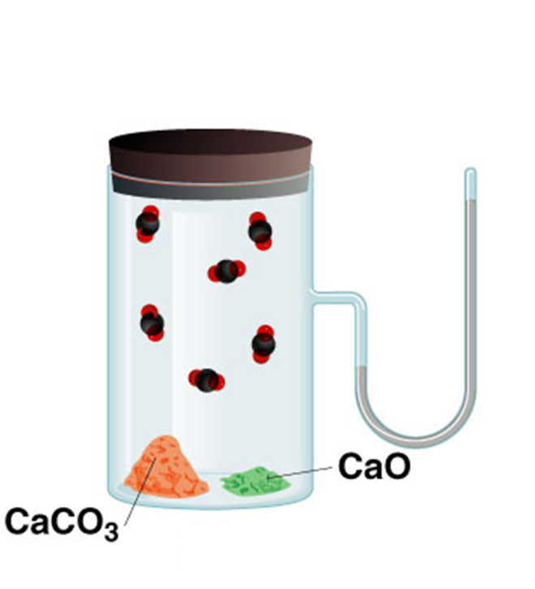
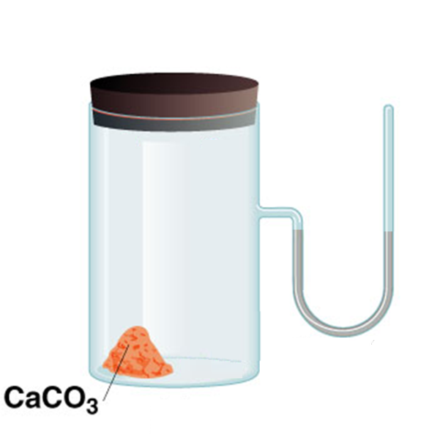
Heterogenous Equilibria
-reacting species are in different phases.
Can include liquids, gases and solids as either reactants or products.
Note CaO will not form a neat separated pile!
CaCO₃ _{(s)} CaO _{(s)} + CO₂ _{(g)}
time

Slide 26
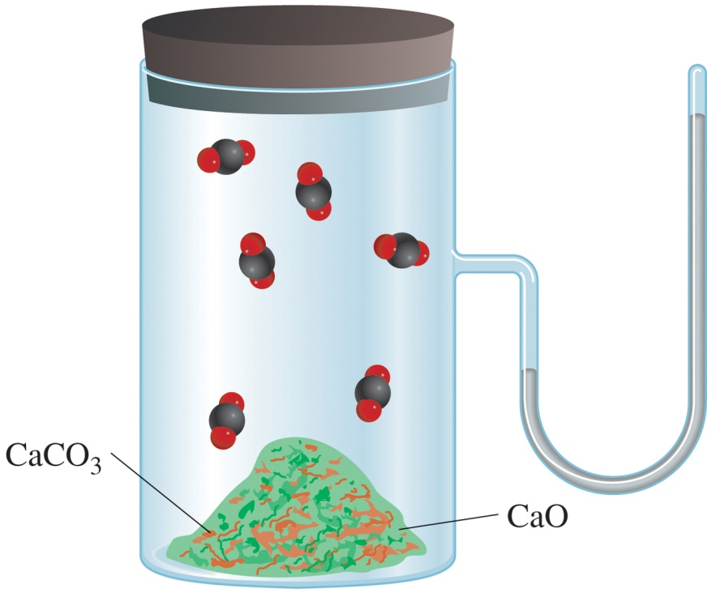
Heterogenous Equilibria
CaCO₃ _{(s)} CaO _{(s)} + CO₂ _{(g)}
CaCO₃ > CaO
CaCO₃ < CaO
P_{CO2} or [CO₂] does not depend on the amount of CaCO₃ or CaO
K_{p} =
P_{CO2}

Slide 27
Heterogenous Equilibria
CaCO₃ _{(s)} CaO _{(s)} + CO₂ _{(g)}
[CaO][CO₂]
K_{c} =
[CaCO₃]
Activity- is a measure of the “effective concentration” of a species in a mixture.
Activity of a solid = 1
[1][CO₂]
K_{c} =
[1]
K_{c} =
[CO₂]
K_{p} = P_{CO}
2
The concentration of solids are not included in the expression for the equilibrium constant.

Slide 28
Consider the following heterogeneous equilibrium:
CaCO_{3(s)} CaO_{(s)} + CO_{2(g)}
At 800°C, the pressure of CO₂ is 0.236 atm. Calculate:
K_{P}
Given T and P_{CO2}
Find K_{p}
K_{p} = P_{CO}
K_{P} = 0.236
2
(b) K_{c}
Have T and K_{p}
Find K_{c}
K_{p} = K_{c}(RT)^{Δn}
R = 0.0821 L atm/K mol
T = 273 + 800 = 1073 K
Δn = 1 – 0 = 1
0.236 = K_{c}(0.0821 x 1073)¹
K_{c} = 2.68 x 10⁻³

Slide 29
Liquids and Solids
The concentration of pure liquids are not included in the expression for the equilibrium constant.
CH₃COOH _{(aq)} + H₂O _{(l)} CH₃COO⁻ _{(aq)} + H₃O⁺ _{(aq)}
[CH₃COO⁻][H₃O⁺]
K_{c} =
[CH₃COOH]
The concentration of solids are not included in the expression for the equilibrium constant.
CaCO₃ _{(s)} CaO _{(s)} + CO₂ _{(g)}
K_{c} =
[CO₂]
K_{p} = P_{CO}
2

Slide 30
Writing Equilibrium Constant Expressions
The concentrations of the reacting species in the condensed phase are expressed in M. In the gaseous phase, the concentrations can be expressed in M or in atm.
The concentrations of pure solids, pure liquids and solvents do not appear in the equilibrium constant expressions.
The equilibrium constant is a dimensionless quantity.
In quoting a value for the equilibrium constant, you must specify the balanced equation and the temperature.

Slide 31
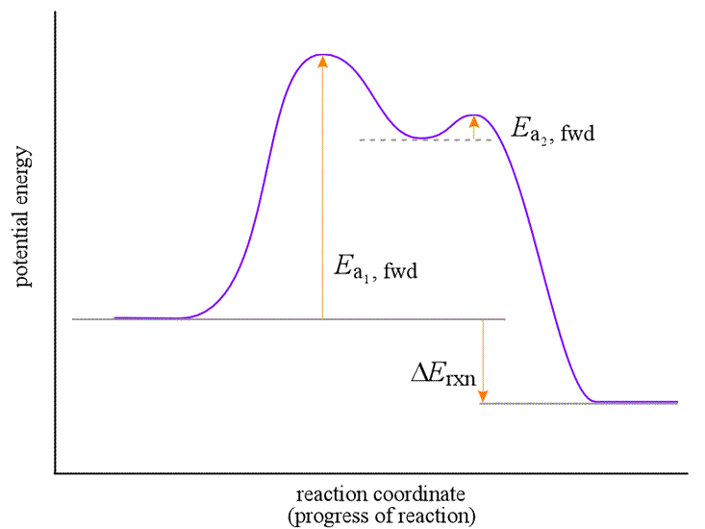
Multiple Equilibria
Step 1:
A B
A B
Step 2:
B C
Overall Reaction:
A C
Reverse Reaction
Reverse Reaction
Forward Reaction
Forward Reaction
B
A
B
A
C
k_{A→B}
k_{A→B}
k_{B→C}
=
K
=
K₁
=
K₂
k_{B→A}
k_{B→A}
k_{C→B}

Slide 32
Multiple Equilibria
A reaction can be an individual reaction step or a multistep reaction.
If the overall reaction is the sum of two or more reactions, the overall reaction Equilibrium Constant is the product of the Equilibrium Constants for the steps

Slide 33
Multiple Equilibria
Product molecules of one equilibrium constant are involved in a second equilibrium process.
‘
[C][D]
A + B C + D
K_{c}
‘
K_{c} =
[A][B]
C + D E + F
‘
‘
K_{c}
[E][F]
‘
‘
A + B E + F
K_{c}
K_{c} =
[C][D]
[C][D]
[E][F]
[E][F]
‘
‘
K_{c}
‘
x
K_{c} =
K_{c} =
x
K_{c}
=
[A][B]
[C][D]
[A][B]
If a reaction can be expressed as the sum of two or more reactions, the equilibrium constant for the overall reaction is given by the product of the equilibrium constants of the individual reactions.

Slide 34
Practice Problem
Determine the overall equilibrium constant for the reaction between Nitrogen & Oxygen to form the toxic gas Nitrogen Dioxide – a component of atmospheric smog
N₂(g) + O₂(g) ⇆ 2NO(g)
K_{c1}
2NO(g) + O₂(g) ⇆ 2NO₂(g)
K_{c2}
Overall: N₂(g) + 2O₂(g) ⇆ 2NO₂(g)

Slide 35
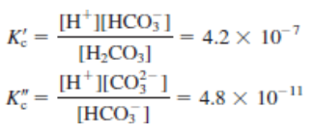
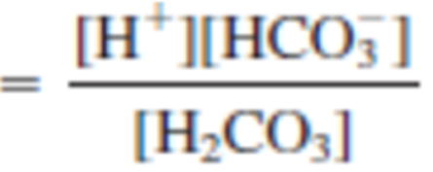
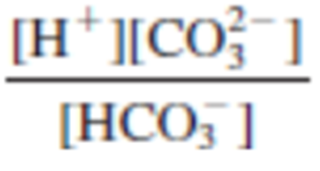
Multiple Equilibria
Overall Equilibrium:
K_{c}
Equilibrium 1:
Equilibrium 2:
Given K’_{c} and K”_{c} what is K_{c}?
x

Slide 36
Rules for Manipulating K
The overall reaction equilibrium constant (K) is the product of the equilibrium constants for the steps.
If the equation is reversed, the equilibrium constant is inverted.
If the equation is multiplied by a factor, the equilibrium constant is raised to the same factor.

Slide 37
Writing Equilibrium Constant Expressions
The concentrations of the reacting species in the condensed phase are expressed in M (K_{c}). In the gaseous phase, the concentrations can be expressed in M (K_{c}) or in atm (K_{p}).
The concentrations of pure solids, pure liquids and solvents DO NOT appear in the equilibrium constant expressions.
The equilibrium constant is a dimensionless quantity.
In quoting a value for the equilibrium constant, you must specify the balanced equation and the temperature.
If a reaction can be expressed as a sum of two or more reactions, the equilibrium constant for the overall reaction is given by the product of the equilibrium constants of the individual reactions.

